Slide 2
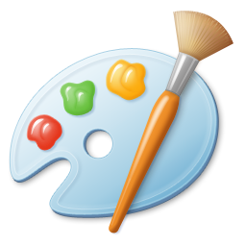





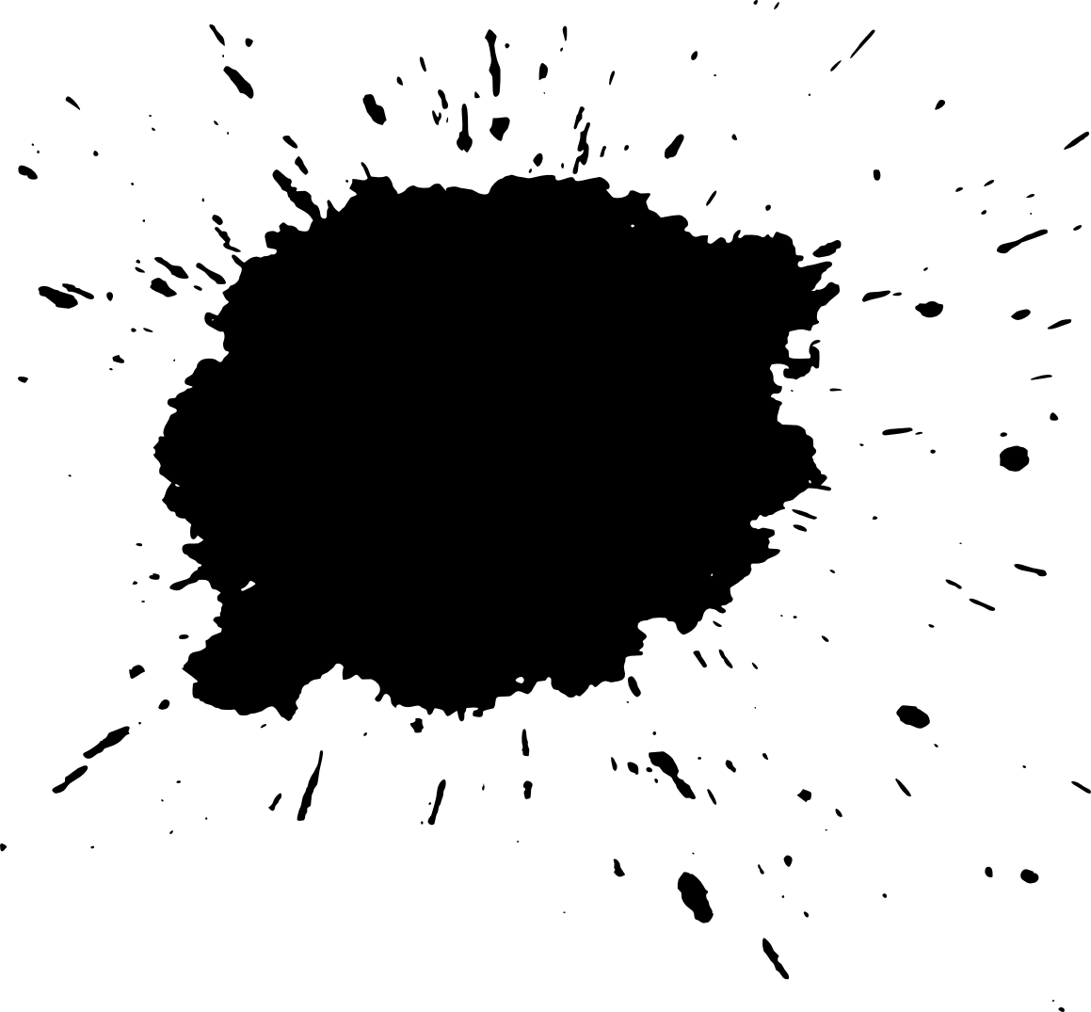
MyPaintShop
SALEM
BAMUKHIER
HUSSAIN HAJJI
Team 3
HASHIM
AL-GHAMDI
SALMAN
AL-GHAMDI
HAITHAM ALSAEED

Slide 3
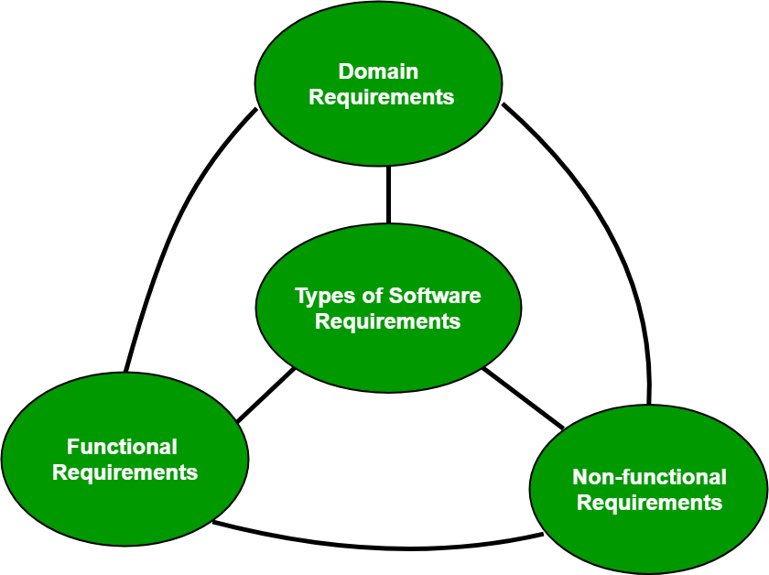
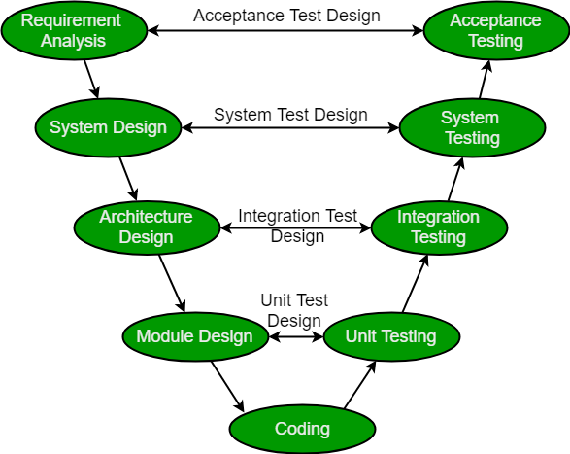
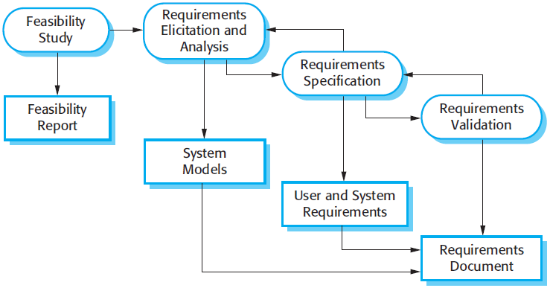
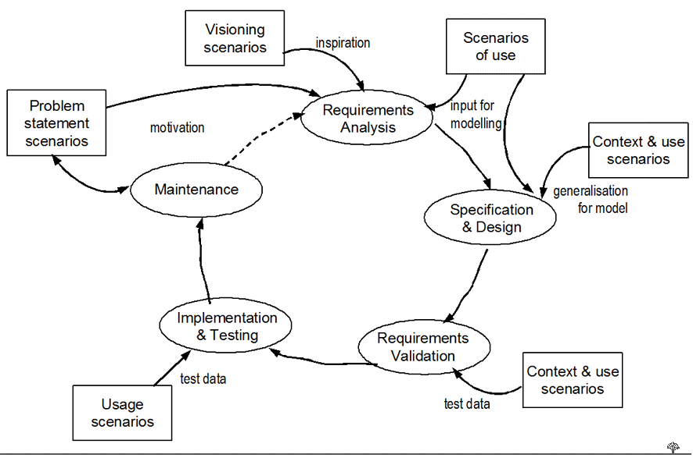
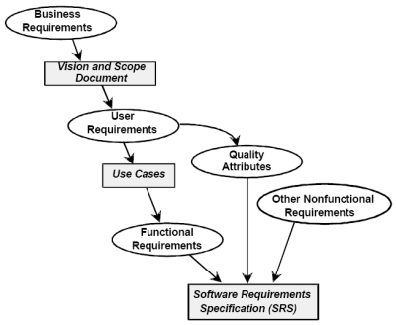
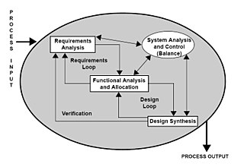
Requirements Phase

Slide 4
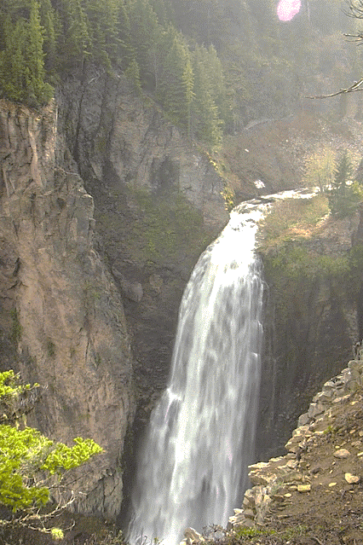
What should we choose
As our process model?
Process Model
Oh…

Slide 5
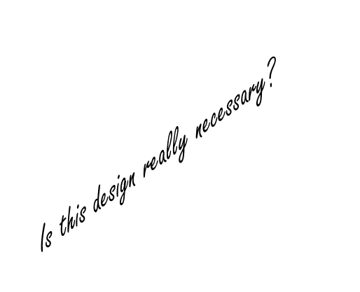
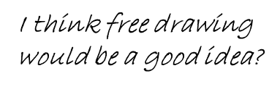
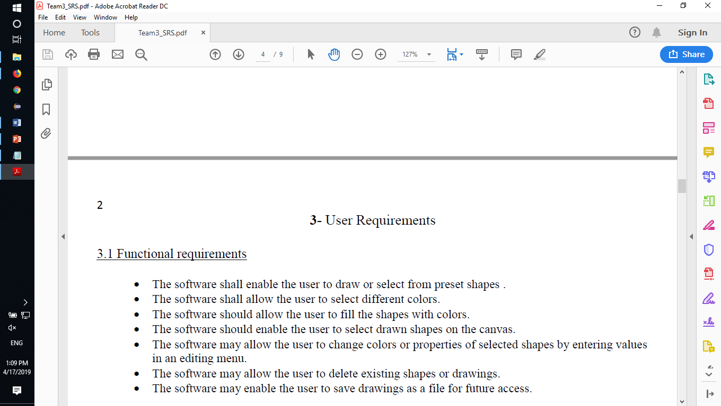
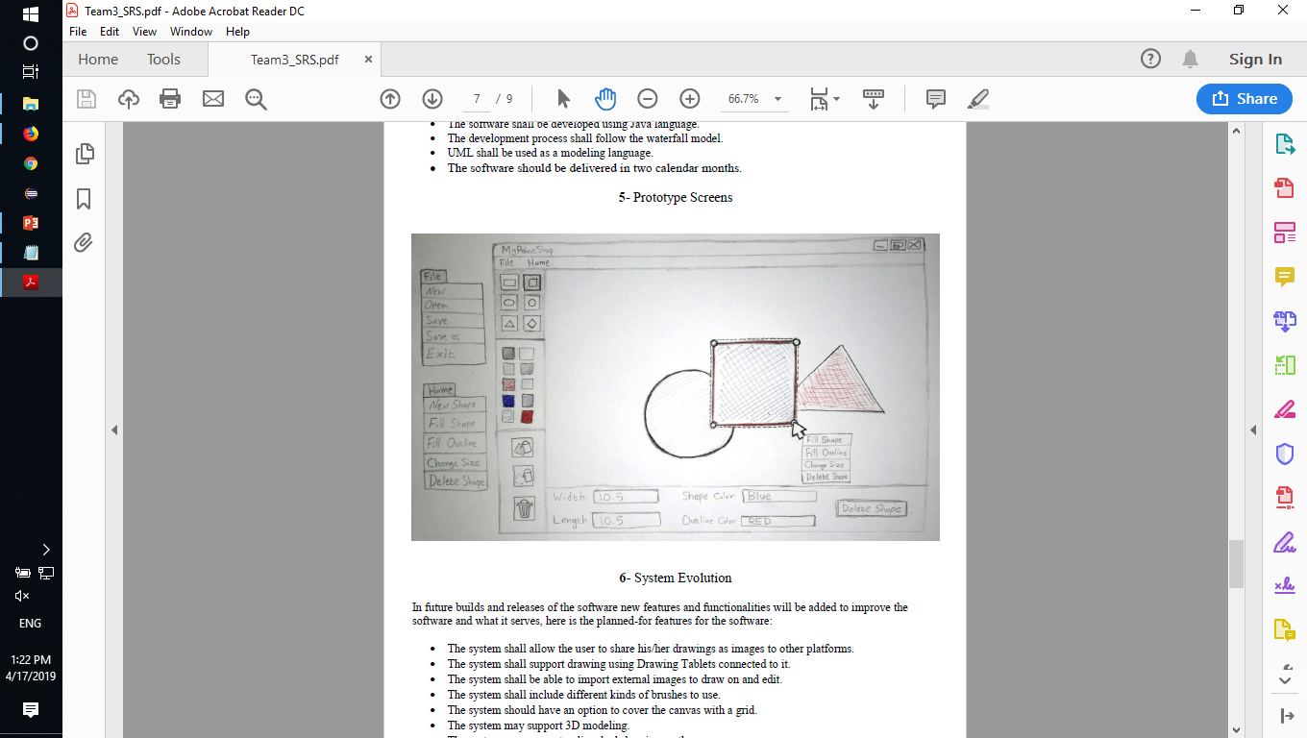
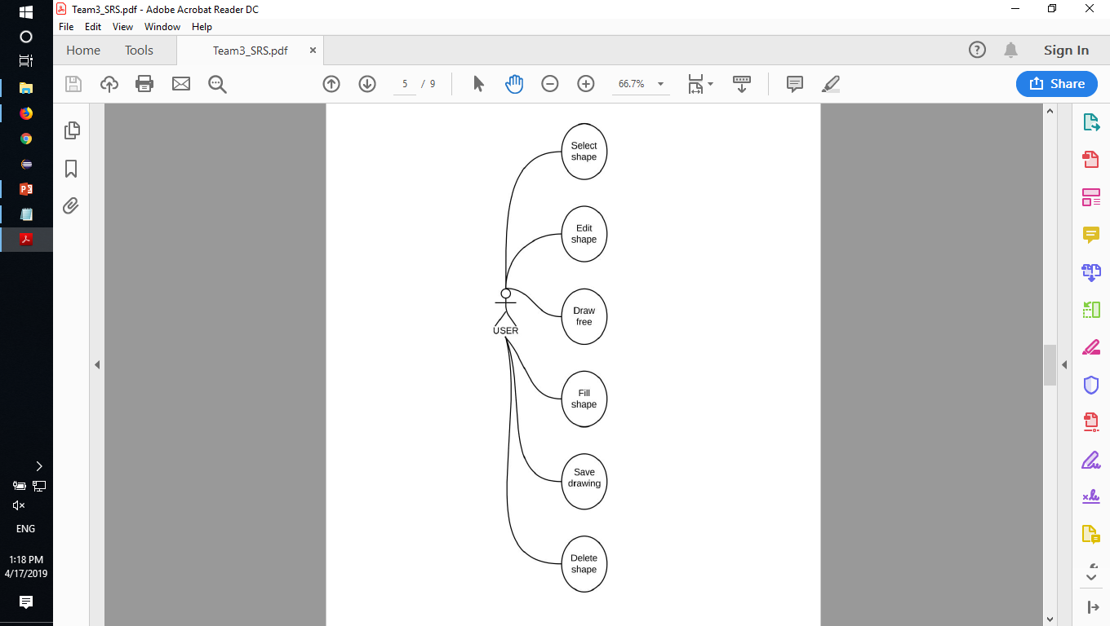
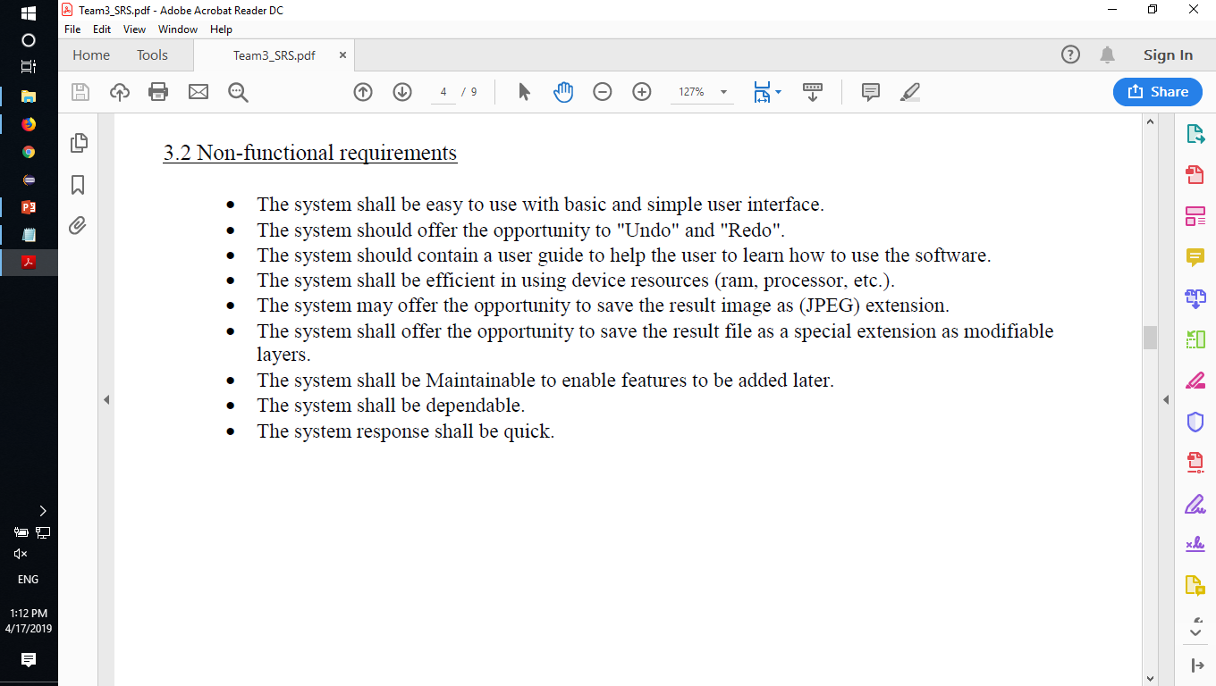
FR and NFR
Use-Case Diagram
Sketch Prototype

Slide 6
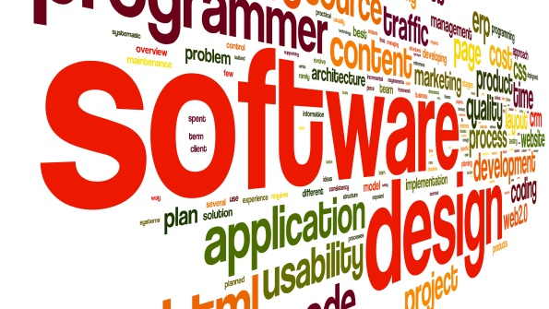
Design
Phase

Slide 7
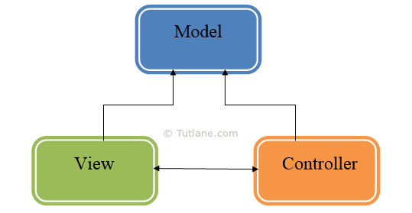
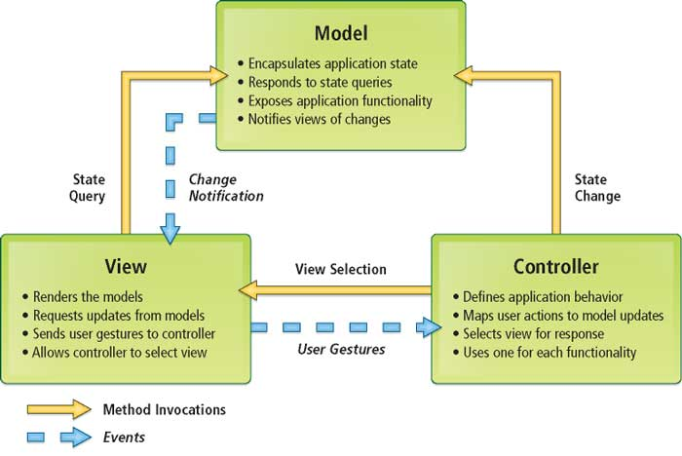
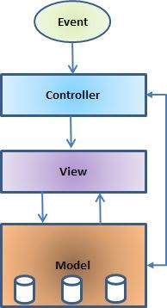
Software Architecture
(MVC)

Slide 8
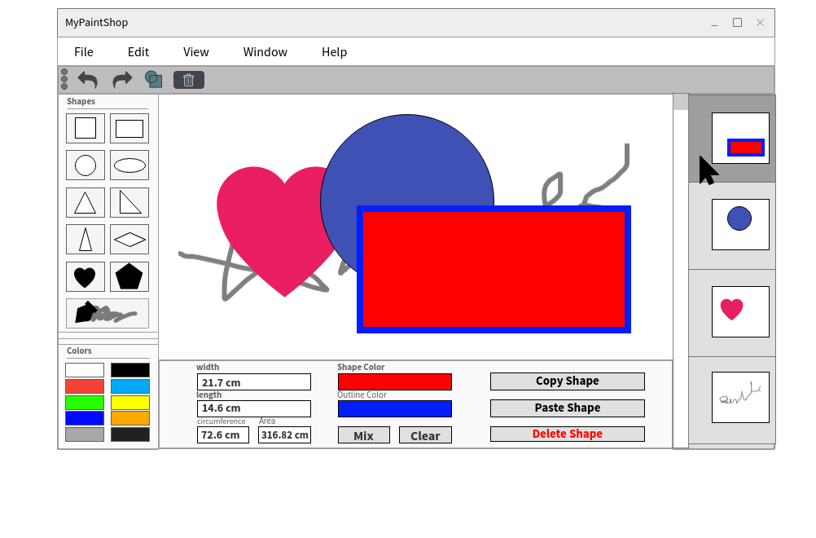
User Interface Design

Slide 9
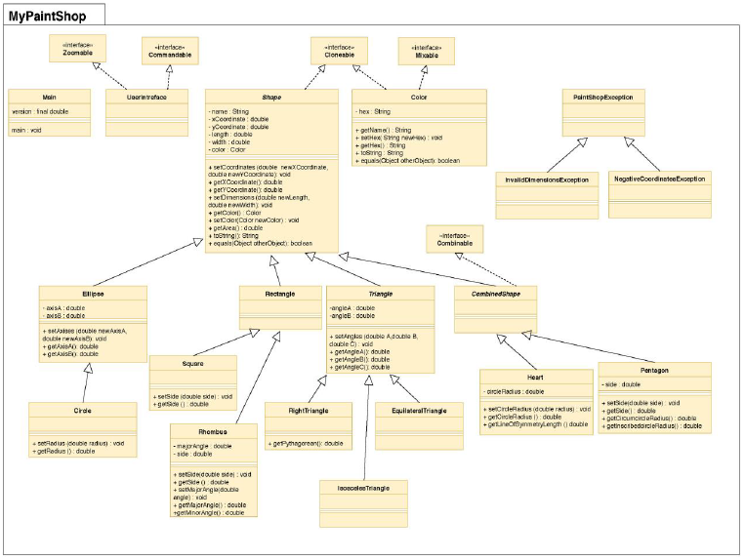
Class Diagram

Slide 10


Slide 12
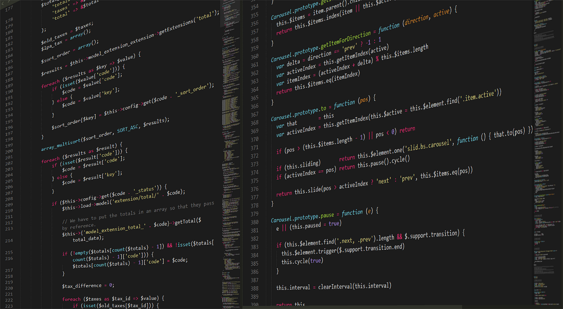
Implementation Phase

Slide 13

Hussain
Hashim
Salem
Salman
Haitham
How we worked on the project?

Slide 14

What makes our project:
The ability to free draw and create shapes.
The ability to change the color of both the shape and its outline.
The ability to change the properties of the shapes in real time.
Completely new shapes that aren’t available in the internal Java libraries.
The ability to undo and redo your work.

Slide 15
Live
demo

Slide 16
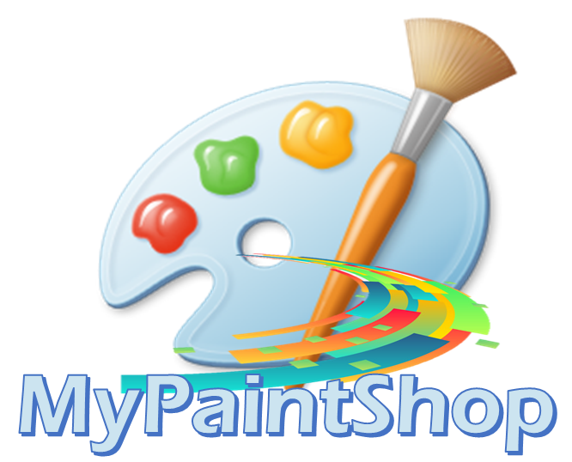
Team 3
Thank you for your attention
The End

